Slide 1
SUPER MARKET BILLING SYSTEM
By
Kotrike Vyshnavi

Slide 2
ABSTRACT
The Supermarket Billing System is a Java-based application designed to simplify the process of product management and billing in a supermarket. It allows the user to log in securely, view available products, select the desired items, and automatically generate a detailed bill with GST calculation. The system interacts with a MySQL database to fetch and manage product information. It also ensures that stock limits are not exceeded and displays error messages for invalid entries. The project demonstrates the use of JDBC connectivity, exception handling, object-oriented programming, and modular design in Java.

Slide 3
TECH STACK
          PROGRAMMING LANGUAGE – JAVA
          DATABASE – MYSQL
          DATABASE CONNECTIVITY – JDBC
          TOOL – MAVEN
          TESTING FRAMEWORK – JUNIT5
          IDE – INTELLIJ IDEA

Slide 4
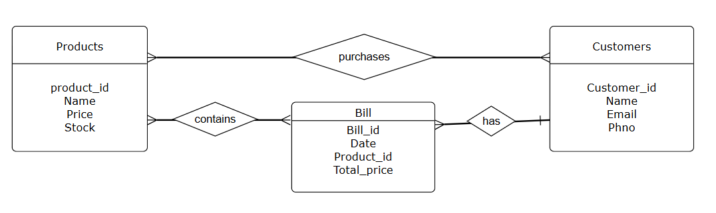
ER-DIAGRAM

Slide 5
Outputs Demonstrate:
Product list display from the database.
User input for product ID and quantity.
Calculation of subtotal, GST, and total bill.
Display of generated bill with current date & time.
Proper exception message when:
  Invalid product ID is entered. Quantity exceeds stock.
  Non-integer or null input is given.
UnitTest Cases:
testSubtotalCalculation(),testGSTCalculation()
testOutOfStock()

Slide 6
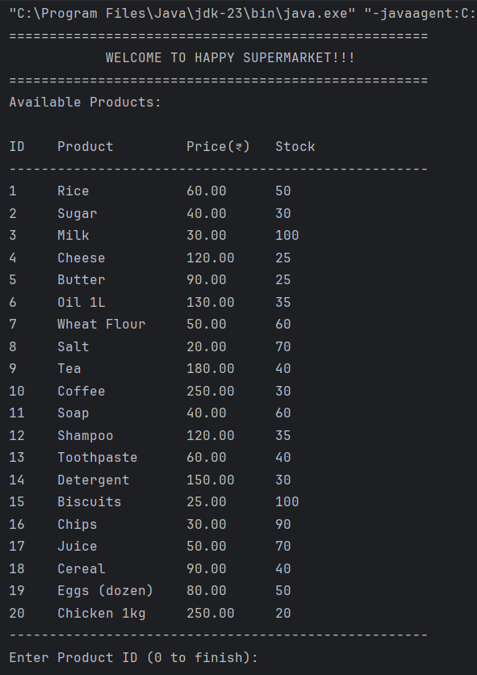
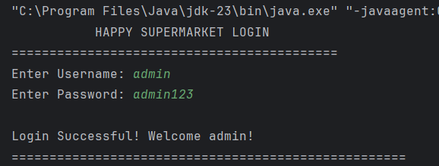
OUTPUT :

Slide 7
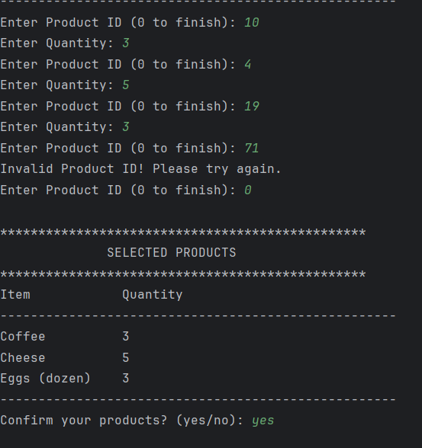
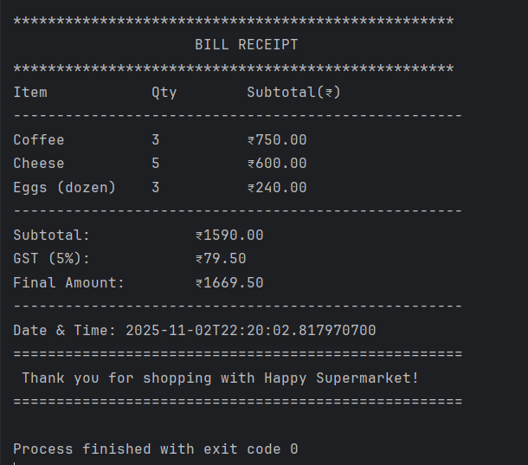

Slide 8
THANK YOU

